Slide 1
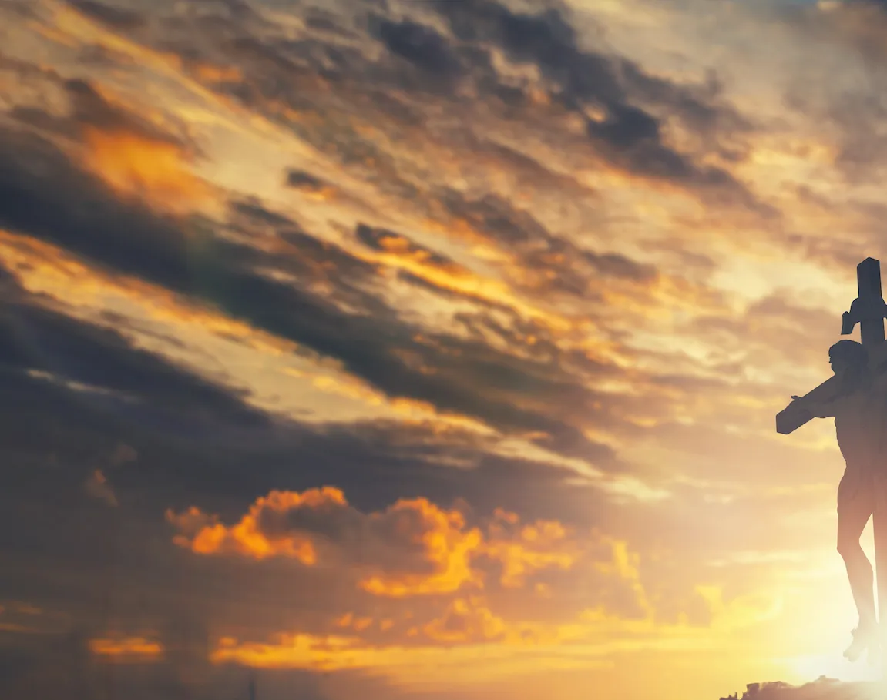
Take My Life
And Let It Be

Slide 2
C CAPO 5th
C
Take my life and let it be
Am G F
Consecrated, Lord, to Thee.
Am F
Take my moments and my days,
F G
Let them flow in ceaseless praise.
F G C
Let them flow in ceaseless praise

Slide 3
C F
Take my hands, and let them move
Am G F
At the impulse of Thy love;
Am F
Take my feet and let them be
F G
Swift and beautiful for Thee,
F G C
Swift and beautiful for Thee.

Slide 4
C F
Take my voice, and let me sing
Am G F
Always, only, for my King;
Am F
Take my lips, and let them be
F G
Filled with messages from Thee,
F G C
Filled with messages from Thee.

Slide 5
C F
Take my will, and make it Thine;
Am G F
It shall be no longer mine.
Am F
Take my heart; it is Thine own;
F G
It shall be Thy royal throne,
F G C
It shall be Thy royal throne.

Slide 6
C F
Take my love; my Lord, I pour
Am G F
At Thy feet its treasure store.
Am F
Take myself, and I will be
F G
Ever, only, all for Thee,
F G C
Ever, only, all for Thee.
END

Slide 7
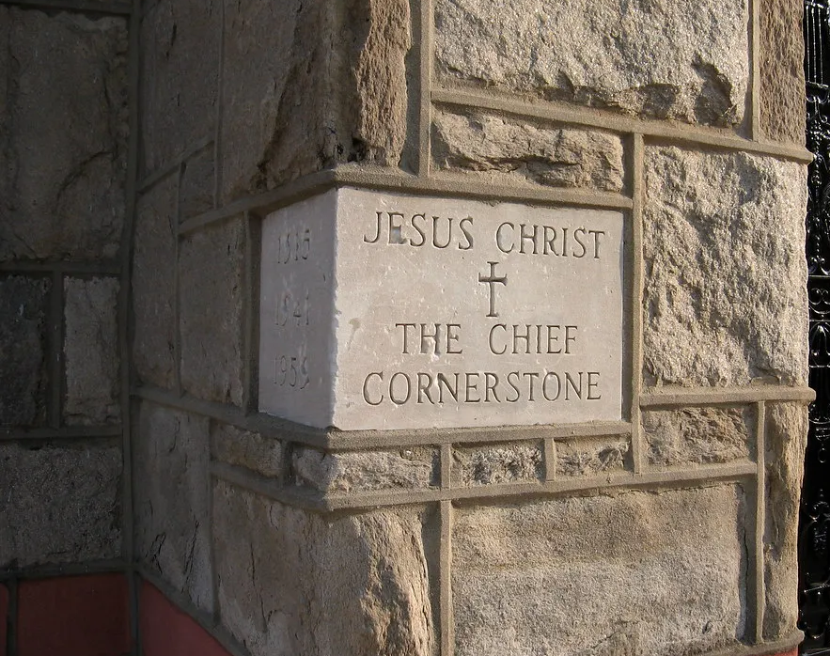
Cornerstone

Slide 8
C / Am / F / G CAPO at 5th
C
My hope is built on nothing less
F G
Than Jesus' blood and righteousness
Am Em
I dare not trust the sweetest frame
F G C
But wholly trust in Jesus' name

Slide 9
C F Am G
Christ alone, Cornerstone
C F Am G
Weak made strong in the Savior's love
C F
Through the storm
Am G C
He is Lord Lord of all

Slide 10
C
When darkness seems to hide His face
F G
I rest on His unchanging grace
Am Em
In every high and stormy gale
F G C
My anchor holds within the veil
My anchor holds within the veil

Slide 11
C F Am G
Christ alone, Cornerstone
C F Am G
Weak made strong in the Savior's love
C F
Through the storm
Am G C
He is Lord Lord of all

Slide 12
Am
He is Lord
F G
Lord of all

Slide 13
C F Am G
Christ alone, Cornerstone
C F Am G
Weak made strong in the Savior's love
C F
Through the storm
Am G C
He is Lord Lord of all

Slide 14
C
When he shall come with trumpet sound
F G
Oh may I then in Him be found
Am Em
Dressed in His righteousness alone
F G C
Faultless, stand before the throne
F / Am / G/ C
END

Slide 15
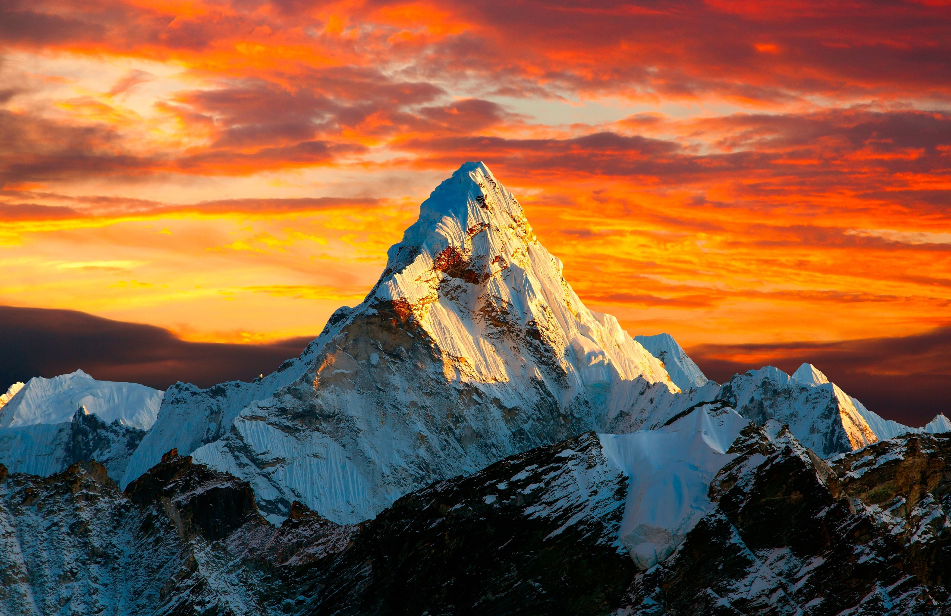
Good Good Father

Slide 16
G
Oh, I’ve heard A thousand Stories
G
Of what they Think you’re like
G G
But I’ve heard The tender whisper of love in the dead of night
C G
And You tell me That you’re pleased
Am D
And that I’m never alone

Slide 17
C
You’re a good good Father
G Am D
It’s who you are, It’s who you are, It’s who you are
C
And I’m loved by You
G Am D
It’s who I am, It’s who I am, It’s who I am

Slide 18
G
Oh, and I’ve seen many searching
For answers Far and wide
G
But I know we’re all searching for answers only you provide
C G
Cause you know just what we need
Am D
before we say a word

Slide 19
C
You’re a good good Father
G Am D
It’s who you are, It’s who you are, It’s who you are
C
And I’m loved by You
G Am D
It’s who I am, It’s who I am, It’s who I am

Slide 20
C Em
Causer You are perfect In all of your ways
Am G
You are perfect In all of your ways
C Em D
You are perfect In all of your ways to us
REPEAT

Slide 21
G
Oh, it’s love so undeniable I, I can hardly speak
Peace so unexplainable I, I can hardly think
C D
As you call me deeper still
Am G
As you call me deeper still
C G
As you call me deeper still
Am D
Into Love Love Love

Slide 22
C
You’re a good good Father
G Am D
It’s who you are, It’s who you are, It’s who you are
C
And I’m loved by You
G Am D
It’s who I am, It’s who I am, It’s who I am
REPEAT 2x and END

Slide 23
Holy Forever

Slide 24
F Am G C/E Am G
C F C
A thousand generations falling down in worship
Am G F
To sing the song of ages to the Lamb
C F C
And all who've gone before us and all who will believe
Am G F
Will sing the song of ages to the Lamb

Slide 25
F Am
Your name is the highest
G
Your name is the greatest
Am F
Your name stands above them all
F Am
All thrones and dominions
G
All powers and positions
Am Dm
Your name stands above them all

Slide 26
F Am G
And the angels cry: "Ho-o-ly"
C Am
All creation cries: "Ho-o-ly"
Dm G
You are lifted high, ho-o-ly
C Csus4 C
Holy fore - ver

Slide 27
C F C
If you've been forgiven and if you've been redeemed
Am G F
Sing the song forever to the Lamb
C F C
If you walk in freedom and if you bear His name
Am G F
Sing the song forever to the Lamb
Am G F
We'll sing the song forever and amen

Slide 28
F Am G
And the angels cry: "Ho-o-ly"
C Am
All creation cries: "Ho-o-ly"
Dm G
You are lifted high, ho-o-ly
C Csus4 C
Holy fore - ver

Slide 29
C F Am G
Hear your people sing: "Ho-o-ly"
C Am
To the King of Kings: "Ho-o-ly"
Dm G
You will always be ho-o-ly
C Csus4 C
Holy fore - ver

Slide 30
F Am
Your name is the highest
G
Your name is the greatest
Am F
Your name stands above them all
F Am
All thrones and dominions
G
All powers and positions
Am Dm
Your name stands above them all
1 of 2

Slide 31
F Am
Your name is the highest
G
Your name is the greatest
Am F
Your name stands above them all
F Am
All thrones and dominions
G
All powers and positions
Am Dm
Your name stands above them all
2 of 2

Slide 32
F Am G
And the angels cry: "Ho-o-ly"
C Am
All creation cries: "Ho-o-ly"
Dm G
You are lifted high, ho-o-ly
C Csus4 C
Holy fore - ver

Slide 33
C F Am G
Hear your people sing: "Ho-o-ly"
C Am
To the King of Kings: "Ho-o-ly"
Dm G
You will always be ho-o-ly
C Csus4 C
Holy fore - ver

Slide 34
Dm G
You will always be ho-o-ly
C Csus4 C
Holy fore - ver
END

Slide 35
Old Rugged Cross

Slide 36
G
On a hill far away
C
stood an old rugged cross,
D G
The emblem of suff’ring and shame,

Slide 37
G
And I love that old cross
C
where the Dearest and Best
D C G
For a world of lost sinners was slain.

Slide 38
D G
So I’ll cherish the old rugged cross
C G
Till my trophies at last I lay down
G C
I will cling to the old rugged cross
G D G
And exchange it some day for a crown

Slide 39
G
Oh, that old rugged cross,
C
so despised by the world
D G
Has a wondrous attraction for me

Slide 40
G
For the dear Lamb of God
C
left His glory above
D C G
To bear it to dark Calvary

Slide 41
D G
So I’ll cherish the old rugged cross
C G
Till my trophies at last I lay down
G C
I will cling to the old rugged cross
G D G
And exchange it some day for a crown

Slide 42
G
In the old rugged cross,
C
stained with blood so divine,
D G
A wondrous beauty I see;

Slide 43
G
For ’twas on that old cross
C
Jesus suffered and died,
D C G
To pardon and sanctify me

Slide 44
D G
So I’ll cherish the old rugged cross
C G
Till my trophies at last I lay down
G C
I will cling to the old rugged cross
G D G
And exchange it some day for a crown
END

